Slide 1


Global Superstore Profit and Sales Visualisation

Slide 2
Introduction of dataset
Order Date
Ship Date
Ship Mode
Customer Name
Segment
City
State
Country
Postal Code
Market
Product ID
Category
Sub-Category
Product Name
Sales
Quantity
Discount
Profit
Shipping Cost
Order Priority

Slide 3
About the Dataset
The Global Super Store dataset encapsulates the essence of a bustling retail empire, offering a panoramic view of its operations across various dimensions.
With Tableau's powerful visualization tools, we have the means to transform raw data into actionable insights.
Through interactive dashboards and intuitive charts, we’ll see the complexities of the Global Super Store dataset, empowering stakeholders to make informed decisions that drive success.

Slide 4
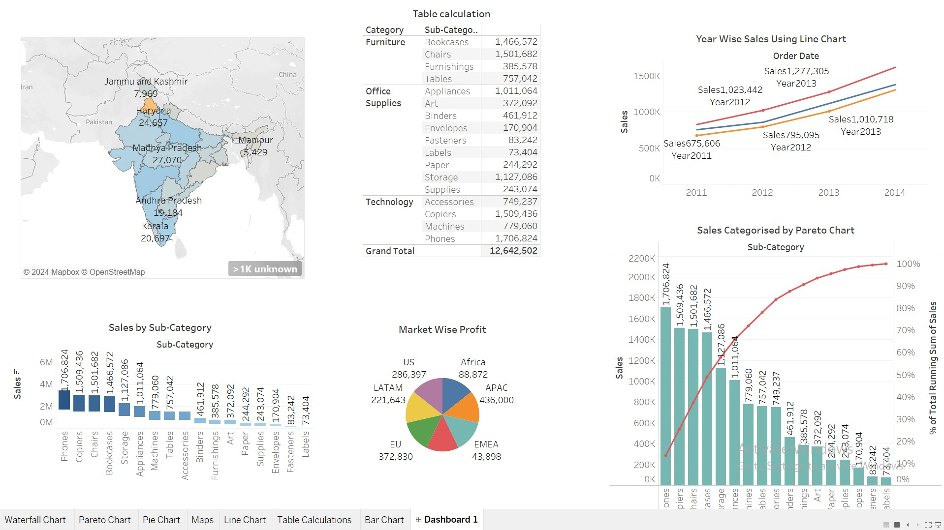

Slide 5
Waterfall chart
By using Waterfall chart I visualised Sales by Sub category
Uses-Waterfall charts in Tableau succinctly illustrate sequential changes, making them ideal for depicting financial statements, tracking project progress, visualizing sales performance, and analyzing budget variances with clarity and precision.
Outcome
Phones have highest Sale- 1,706,824
Labels has least sale-73,404

Slide 6
PIE CHART
By using Pie Chart I Visualised Market wise Profit
Uses- Pie chart effectively displays proportional data distributions such as market shares, budget allocations, or demographic compositions. They're useful for highlighting the contribution of each category to the whole, comparing relative sizes quickly, and conveying simple, standalone insights with ease.
Outcome
United States has highest profit-286,397
Europe, Middle East, and Africa has lowest profit-43,898

Slide 7
Line Chart
By using Line Chart I visualised Year wise Sales
Uses- Line charts are valuable for visualizing trends over time, such as sales performance, stock prices, or website traffic.
They provide a clear representation of continuous data points, enabling users to identify patterns and detect fluctuations
Outcome
Sales in 2011- 675,602
2013-1,010,718

Slide 8
Pareto Chart
By using Pareto Chart I visualised Sales
Uses-Pareto charts in Tableau combine bar and line graphs to prioritize factors contributing to a cumulative total, such as identifying the most significant product issues or sales opportunities.
They help focus resources on the most impactful areas by visually highlighting the 80/20 rule
Outcome-
Highest sales-Phones-1,706,824
Lowest Sales-Labels-73,404

Slide 9
Map Chart
Map chart was made by using Sum of Sales & Profit
Uses-Map charts in Tableau are ideal for visualizing geographical data, such as customer locations, store distributions, or sales territories. They provide a spatial representation of data, enabling users to identify patterns, trends, and outliers across regions.
State wide Sales is shown in the map chart
Outcome-
Punjab has highest sales

Slide 10
Table calculations
Table calculations in Tableau enable dynamic analysis by computing values based on the data within a visualization, allowing for comparisons, trends, and percentages.
They facilitate complex calculations such as moving averages, running totals, and percent of total, enhancing insights into data patterns.
Outcome-
Sub category and category sales were taken into consideration and grand total was taken

Slide 11
Thank you

